Slide 1
STOCK MARKET ANALYSIS

Slide 2

PRESENTED BY
Pragati galinde

Slide 3
PROJECT SUMMARY
Explore the data to uncover patterns, correlations, and insights. This may involve statistical analysis, visualization techniques, and time series analysis to understand the behavior of stocks and market trends.
The goal was to draw insights to make decision regarding the stock purchases, sales and holdings.
The stock market data was analyzed using Excel, PowerBI, Tableau and MySQL.

Slide 4
OBJECTIVE OF STOCK MARKET ANALYSIS
Average Daily Trading Volume.
Most volatile Stock.
Stocks with Highest Dividend and Lowest Dividend.
Highest and Lowest P/E Ratio.
Stock with Highest Market Cap.
Stock near 52 week high and 52 week low.

Slide 5
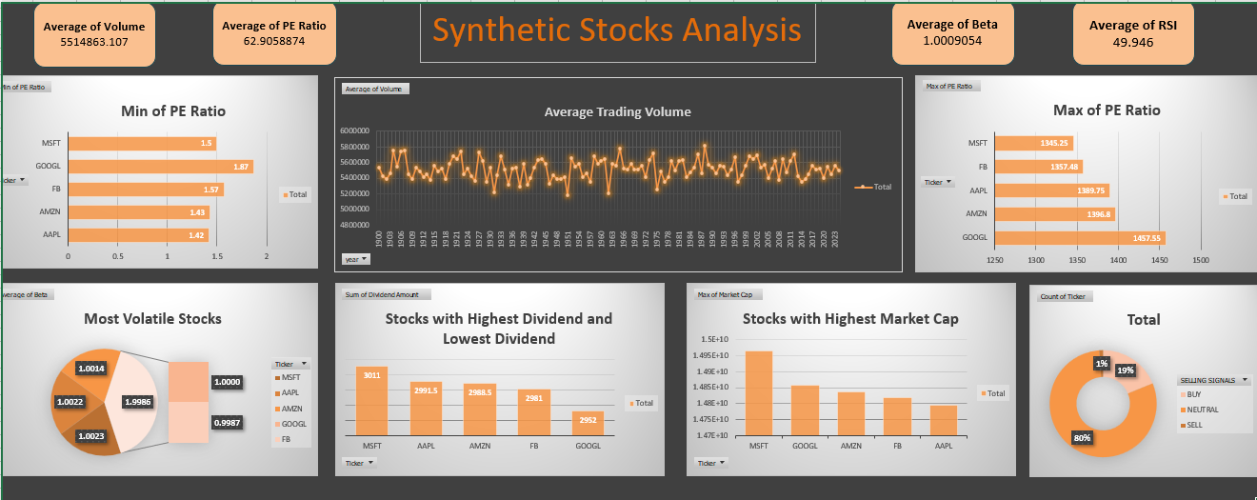
EXCEL DASHBOARD

Slide 6
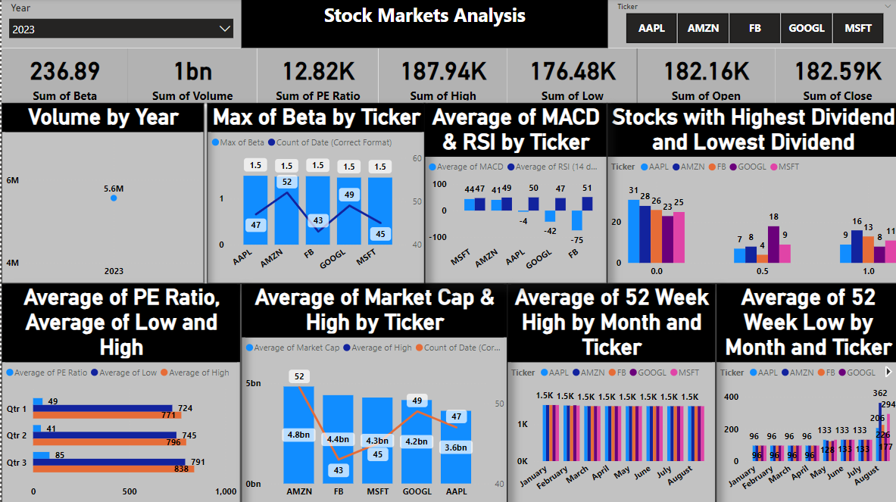
POWERBI DASHBOARD

Slide 7
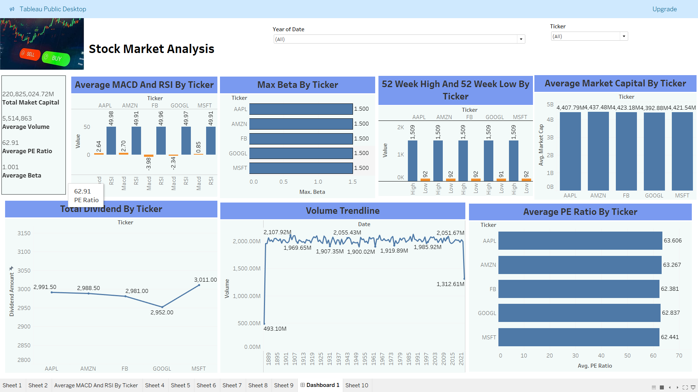
TABLEAU DASHBOARD

Slide 8
KEY TAKE AWAY
To draw insights regarding stock purchases sales and holdings, following aspects has been covered:-
  Beta to check volatility of stock
  PE Ratio to check growth of stock
  MACD And RSI to generate Buying and selling signal
  Below chart represent the Buying and Selling recommendations on the basis of MACD and RSI

